Slide 1


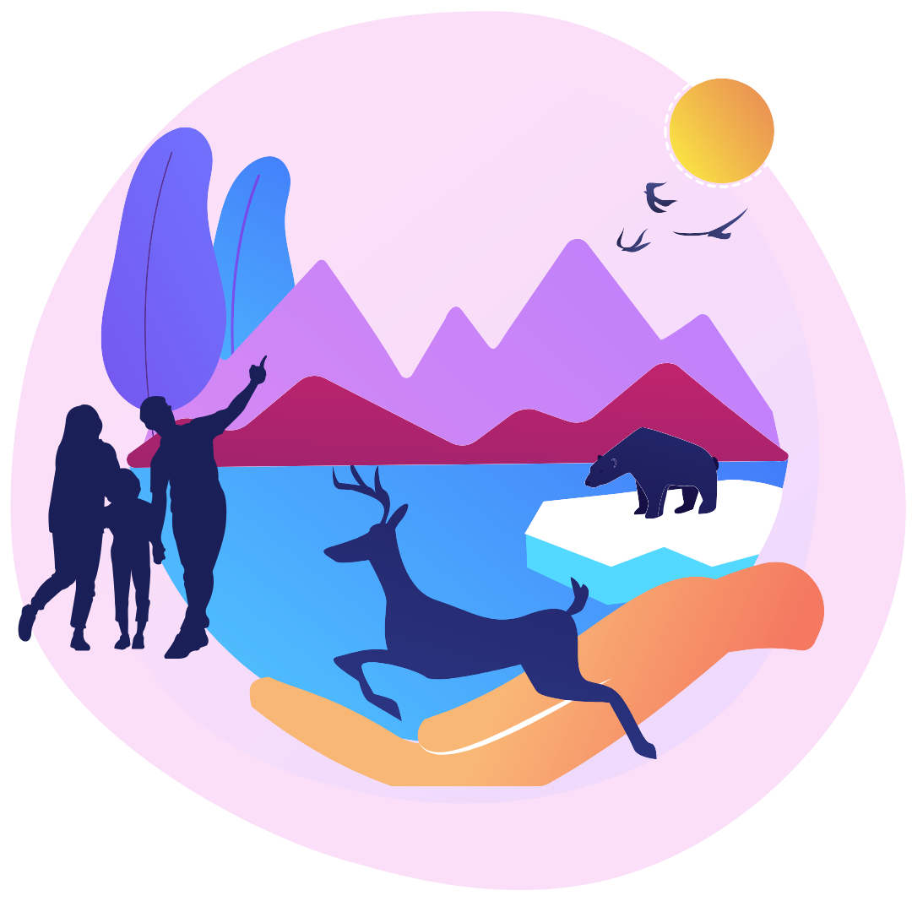
We are all part of creation
We are called by God to care for our common home.

Slide 2
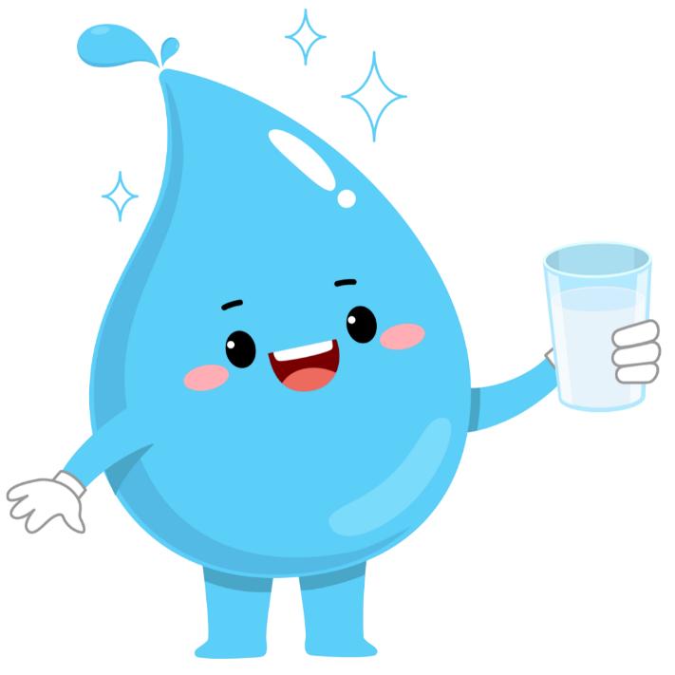


_{top tips to}
Fun facts &
save
water
An educational resource for primary school children

Slide 3
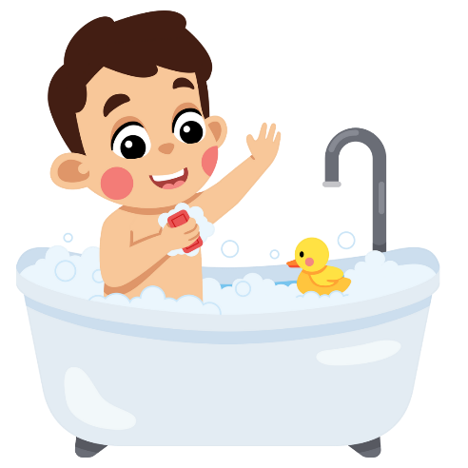
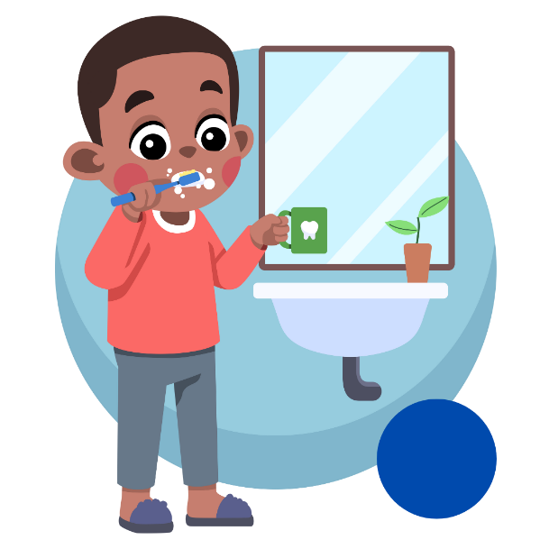
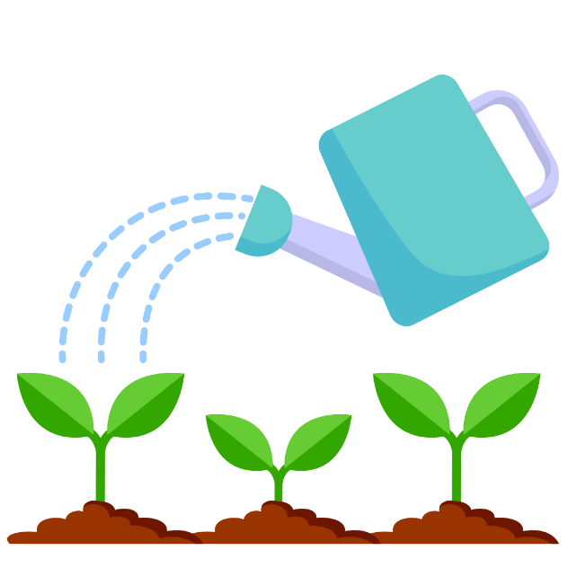
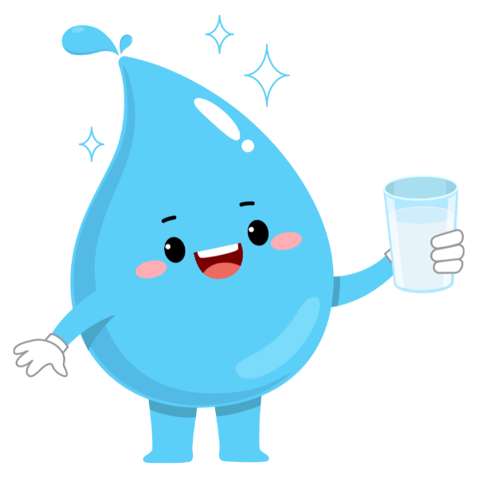
How many different ways do we use water?

Slide 4

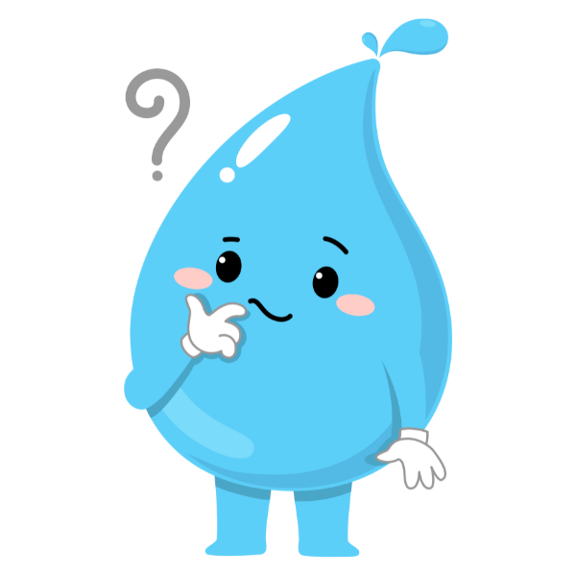
for a
It’s time
water
saving
quiz
Q1 How much of the Earth’s surface is covered in water?
Q2 How much of the water on this Earth can we actually use?
Q3 How many litres of water does the average person in the UK use in a day?
Q4 How many litres of water are used if a tap is left running for 2 minutes?
Q5 How many filled bathtubs of water does it take to make one pair of jeans and a cotton t-shirt?

Slide 5

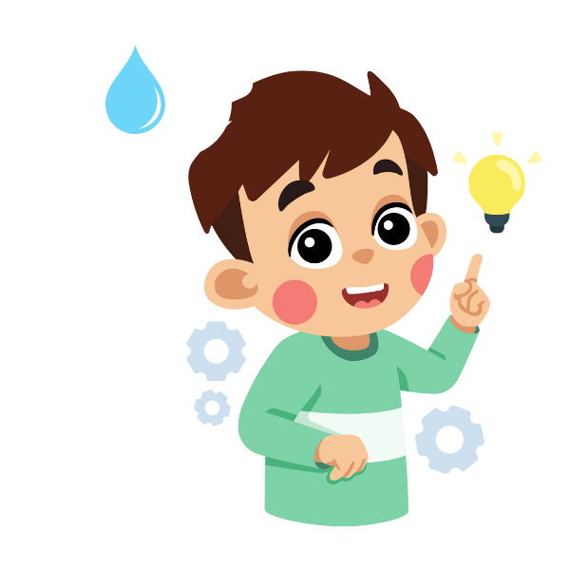
How
well
did you
do
Let’s find out…

Slide 6

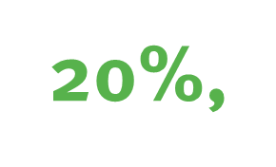
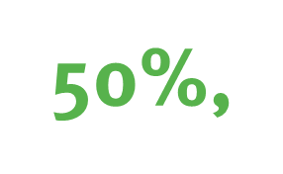
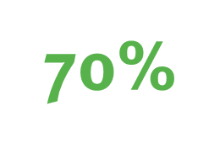



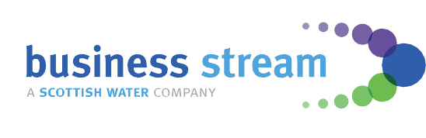
Can you
guess
what percentage of the Earth
is covered in water?
Do you think it’s…

Slide 7




it’s
Do you know what percentage of water can we actually use? Any guesses?

Slide 8

only

Slide 9
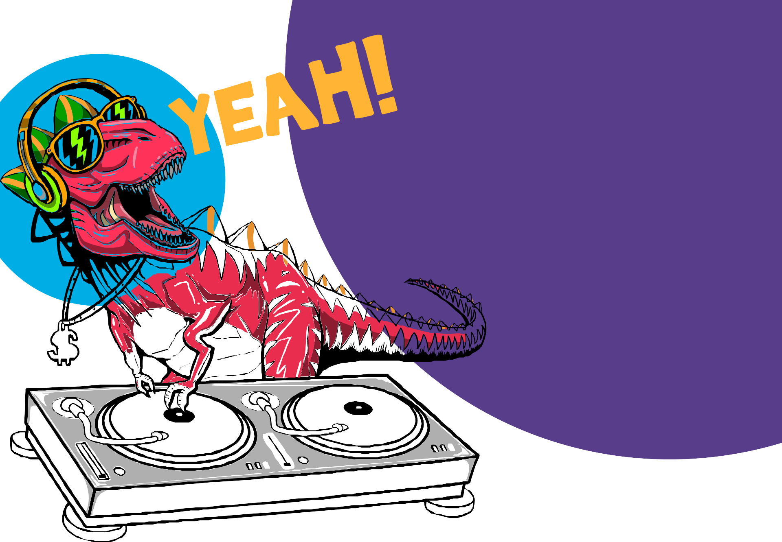
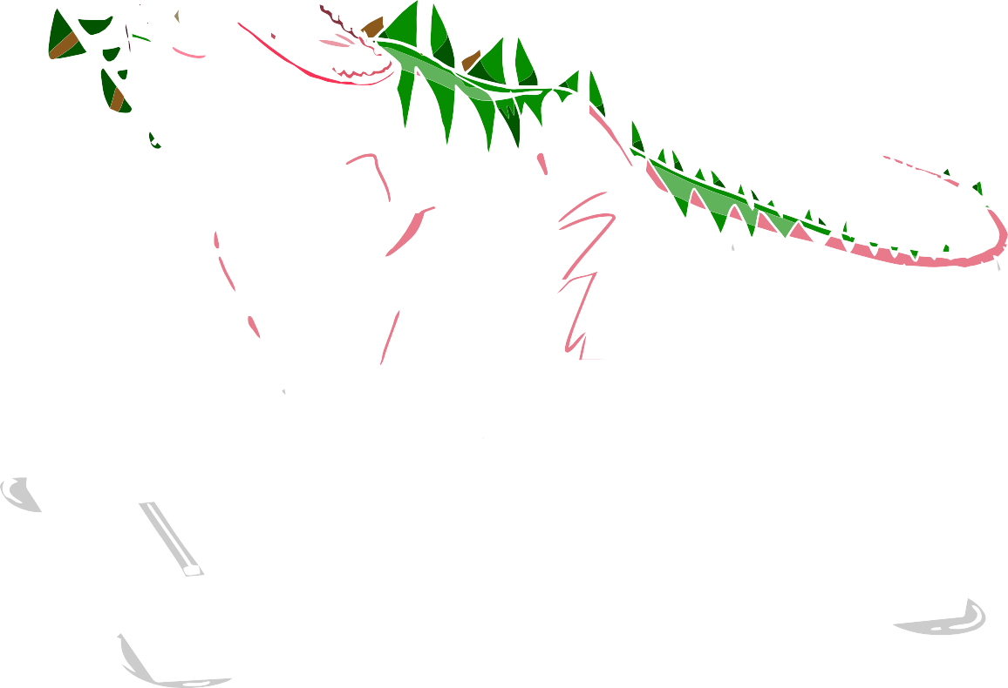
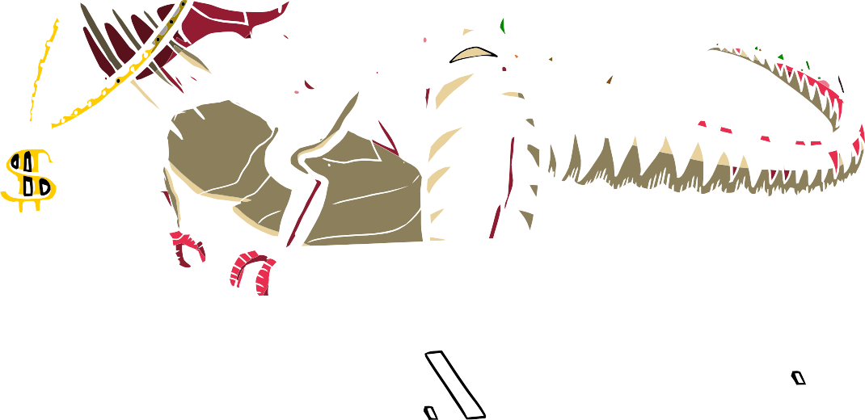
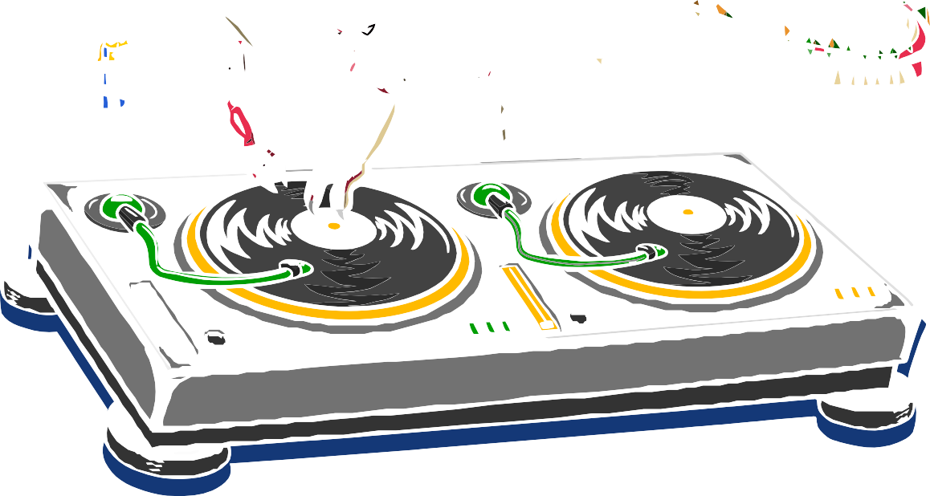

?
fact
coolest
The water we use
today is the same
water that thirsty dinosaurs were gulping about 65 million years ago. …so just think, the water you drink and use to brush your
teeth was once upon a time used by a T-rex!!

Slide 10

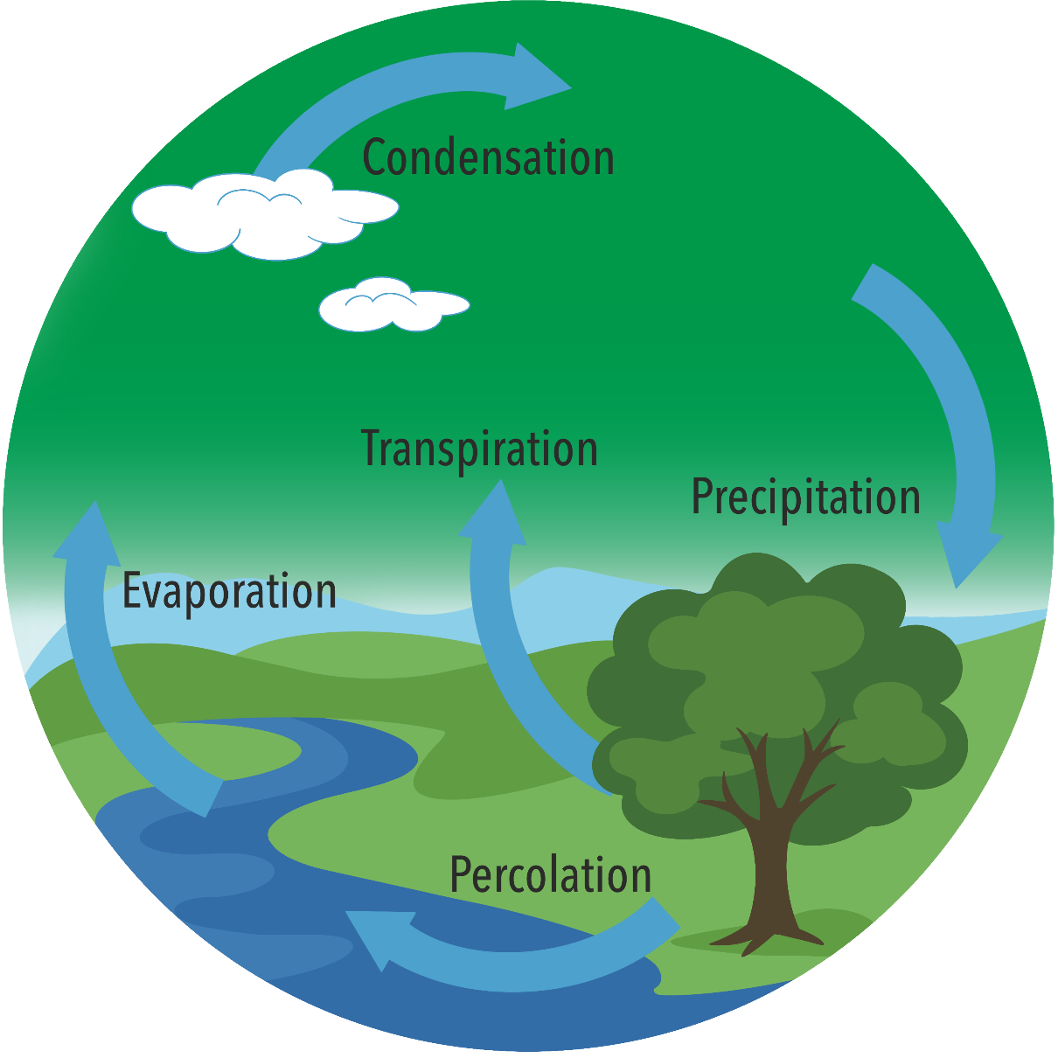
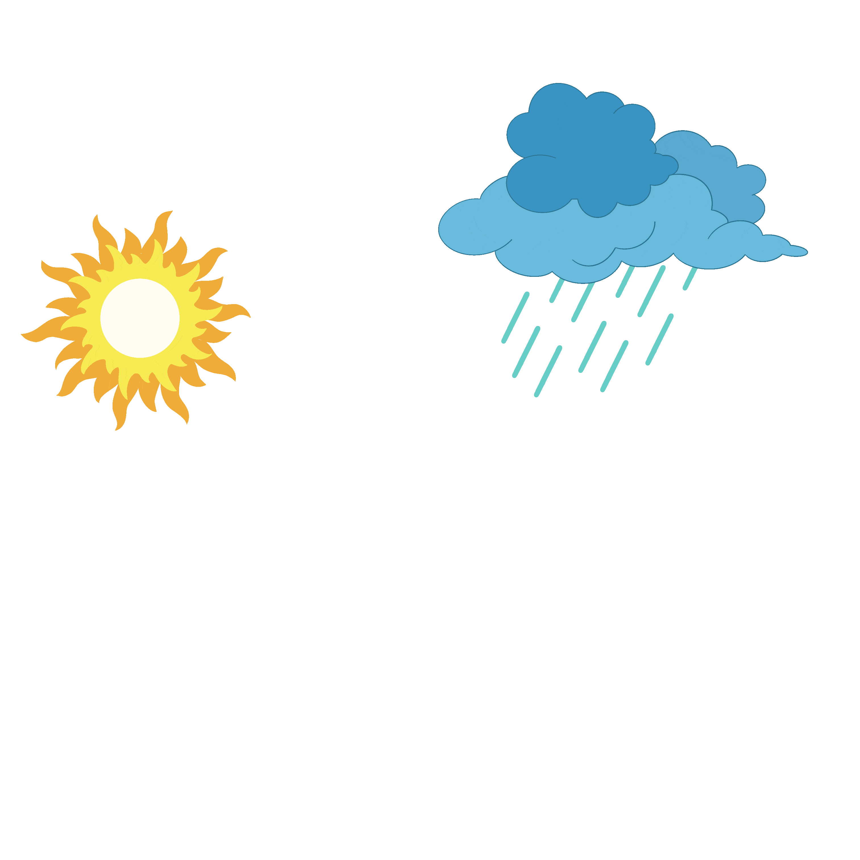

This is called the ‘water cycle’ which
begins with the water in our seas and
rivers, it warms up and rises into the
sky as very tiny droplets. When
it cools down, it forms clouds.
When the clouds get really
heavy the water falls from
the clouds as rain, sleet or
snow, and it goes back into
our seas and rivers. Where
the whole cycle starts again.
This same water has
circulated our planet for nearly

Slide 11

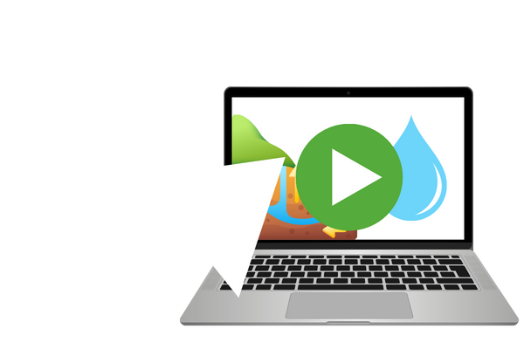
Ready to
sing-along

Slide 12
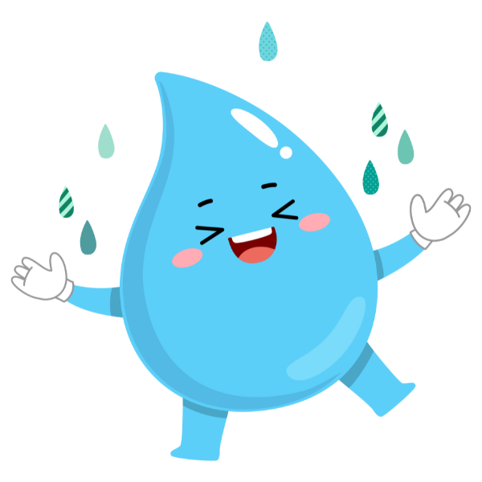

facts
More fun
Any
guesses?
Can you guess how many filled 1 litre bottles of water the average person in the UK goes through in a day?

Slide 13


I bet that was a lot
more than you were
expecting!
We all use
a lot of water and it’s not just for drinking

Slide 14
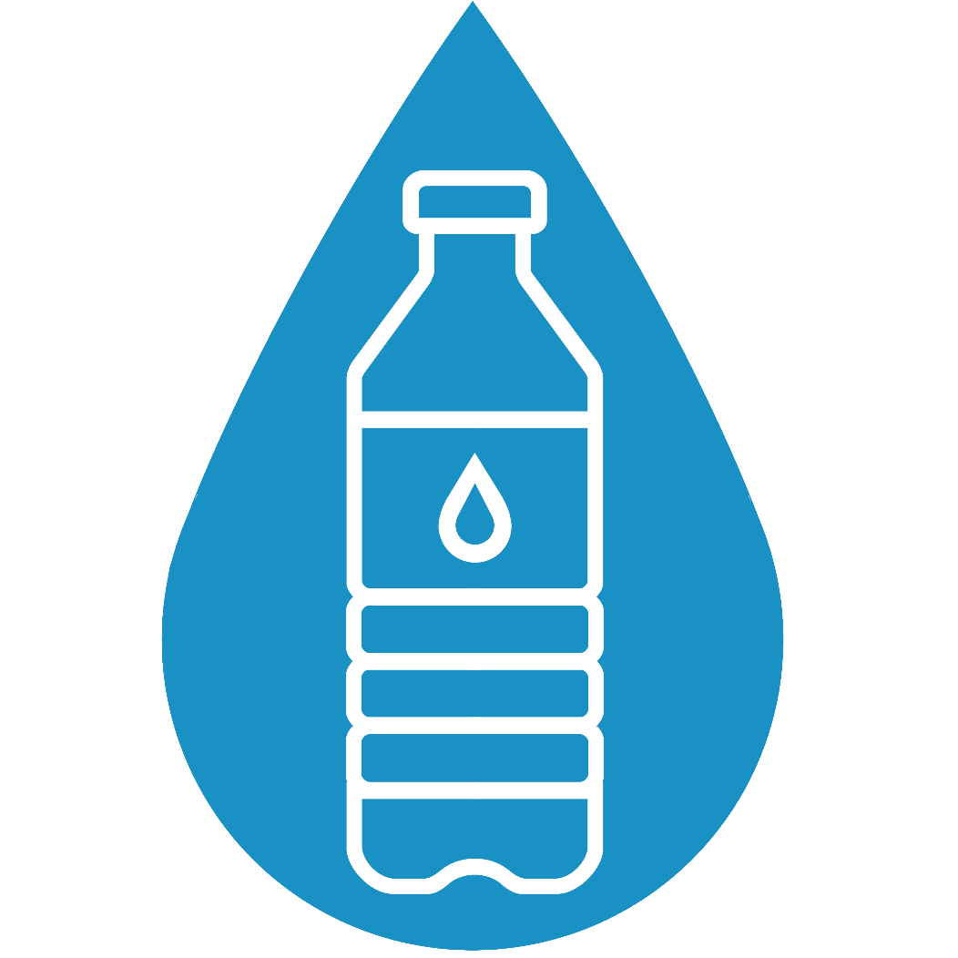
If you brush
your teeth
for the recommended 2 minutes and you leave the tap running all that time, how many of these
litre bottles of water do you think would drain down the sink?
Any
guesses?

Slide 15

so remember to turn off the tap when brushing your teeth!

Slide 16

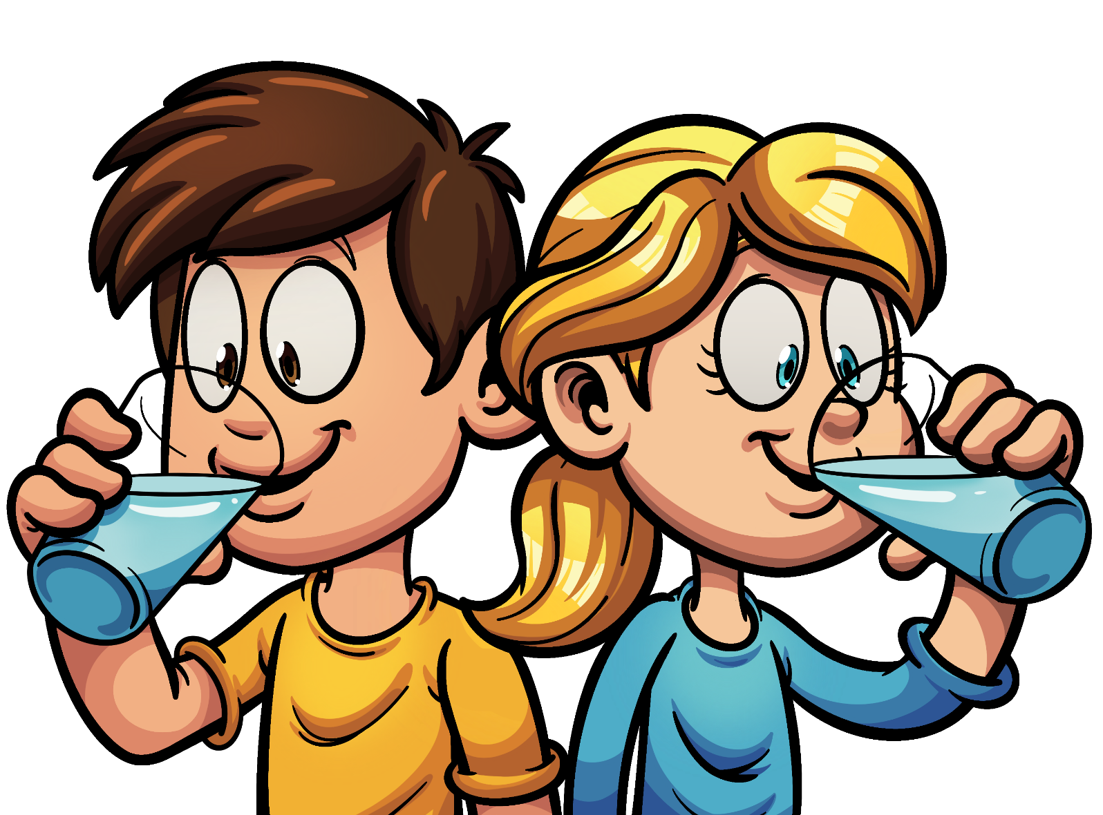
But remember
You should be drinking around 6-8 glasses of water per day!
drinking water
is very important

Slide 17
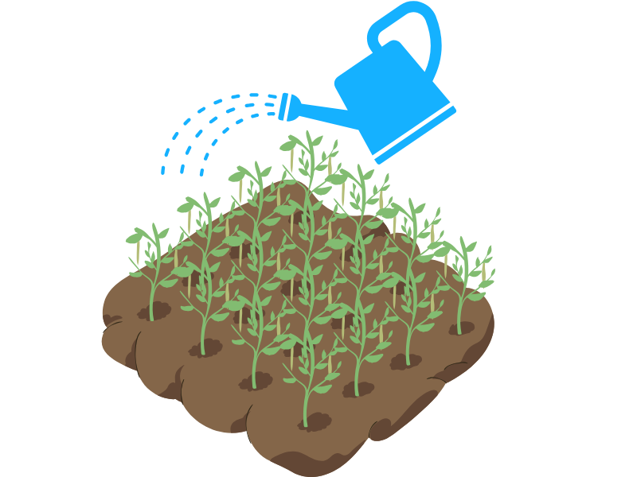
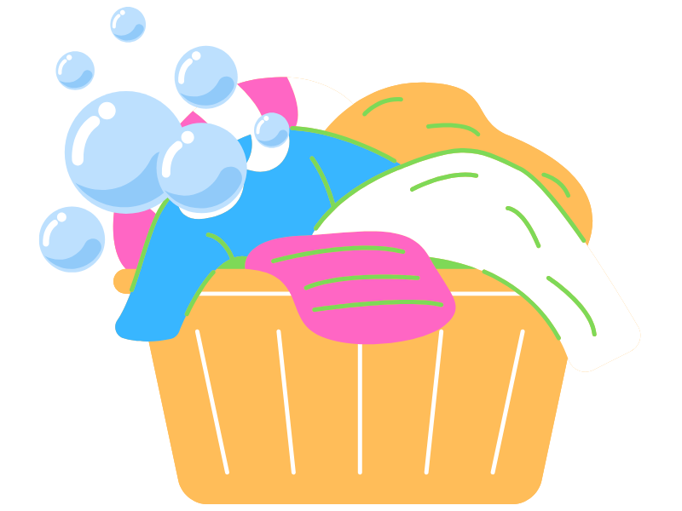
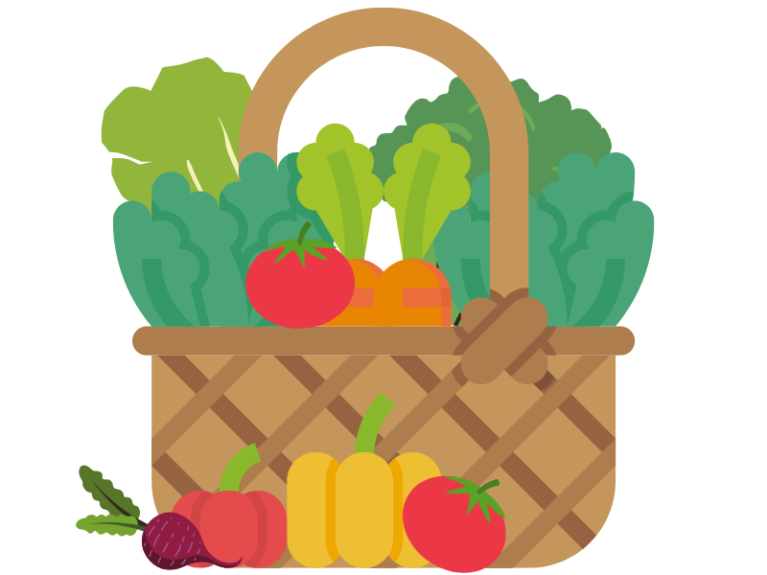
Water
To give
you an example – in a clothing
factory to make one pair of jeans and a cotton t-shirt... would you like to guess how many filled bathtubs of water are
used?
isn’t just used for drinking or bathing.
  Water is used to produce almost everything.

Slide 18
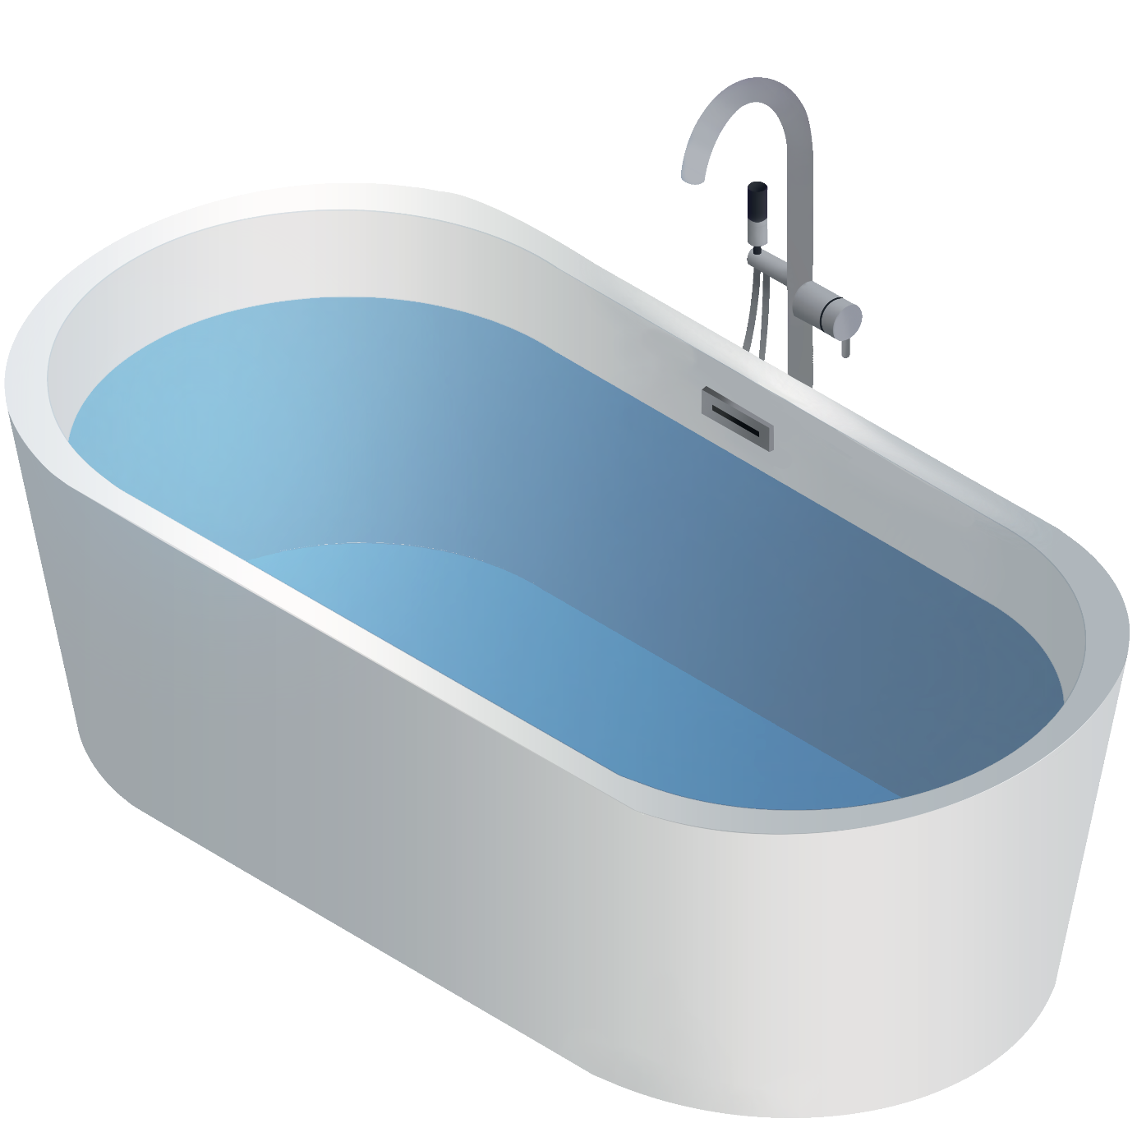
135
bathtubs of water!

Slide 19


Rights &
Every single person, plant and animal on earth needs water.
Everyone has the right to water because it is vital for life.
Responsibilities
We all have a responsibility to look after it now and for the future.
So

Slide 20



Why
should
we use
less
…there are lots of reasons but here are a few of the most important ones
water?

Slide 21
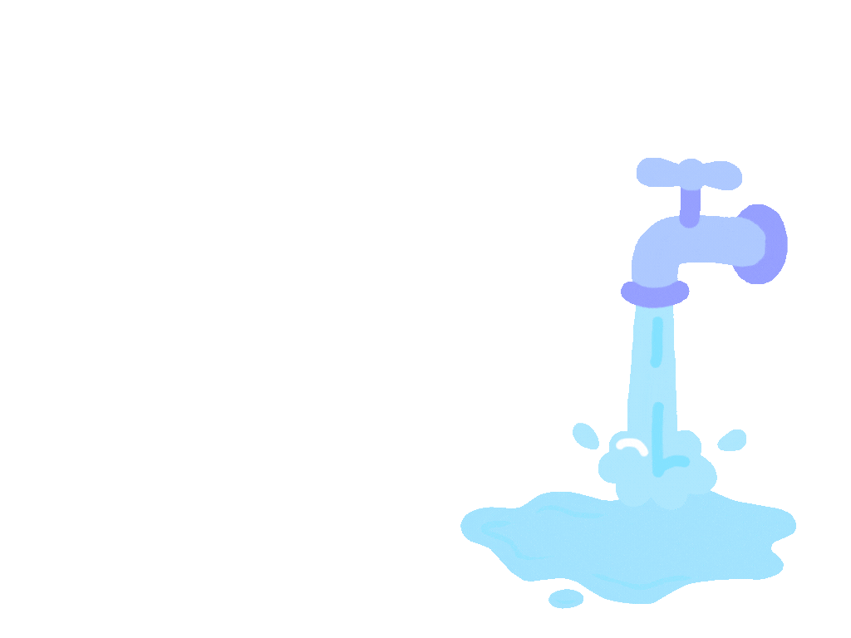
protect
We
need
to
our
water supply
There is a bigger demand for water today than ever before!

Slide 22
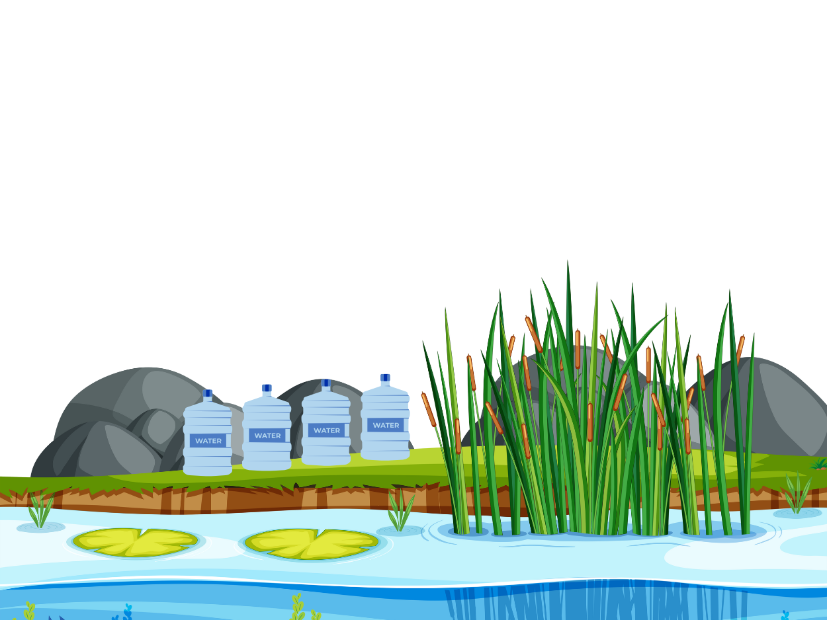
Climate change, new technologies and population growth are putting a strain on our water resources.
By 2050, we are going to need almost 5 billion litres a day more to meet water needs in parts of the UK.
^{Environment Agency (2024)}

Slide 23
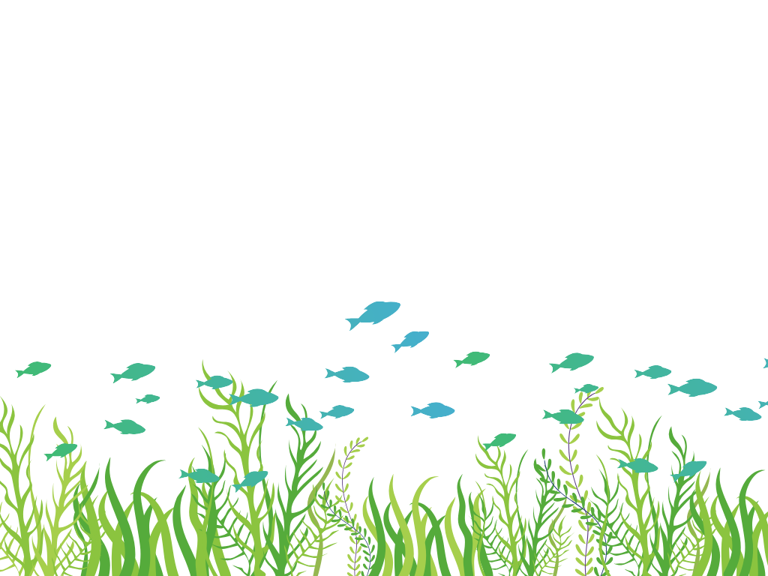
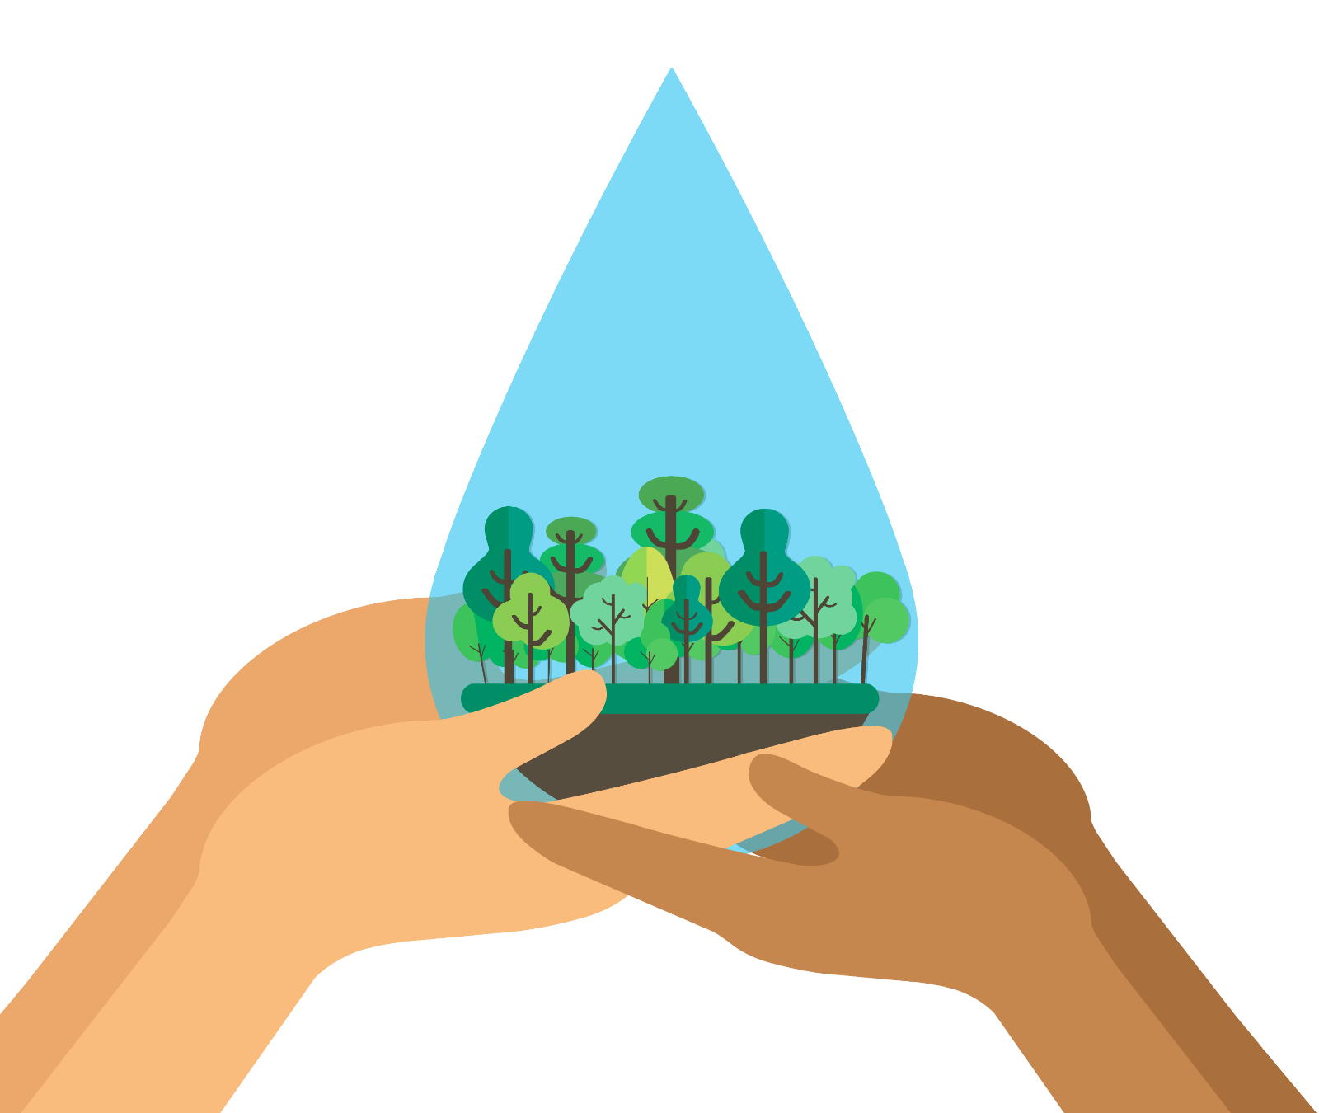
Protect
the
environment
By using less water, we can help to save wildlife too!

Slide 24
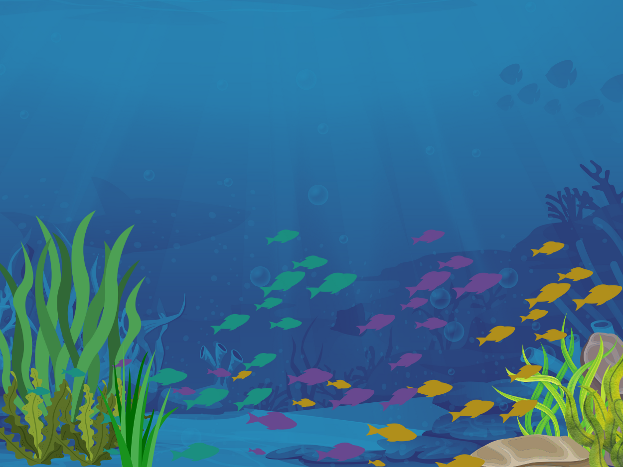

To make sure we have enough water, we sometimes need to extract water from rivers – which is then treated and used in our homes, schools and businesses. But this can lead to…
Changing of migration patterns in fish which can disrupt their lifecycle
Higher concentration of pollution in rivers, due to the decrease in water
Reduced oxygen levels in rivers, harming plants and wildlife

Slide 25


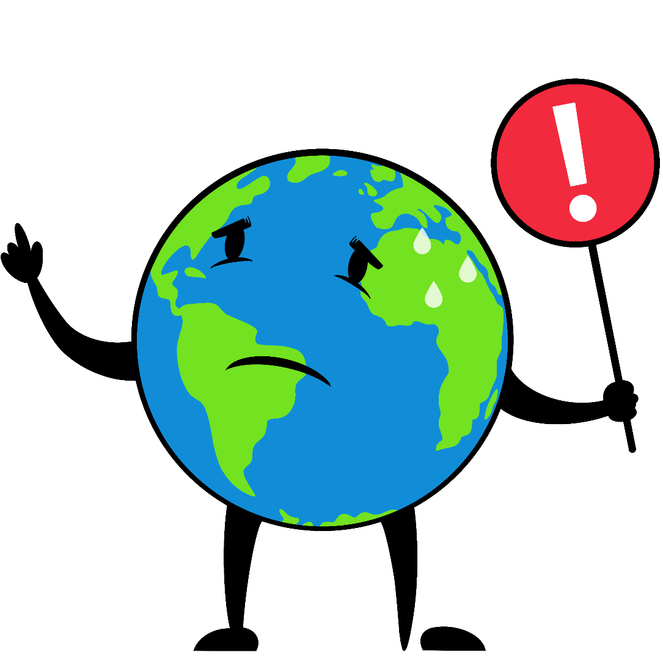
Help tackle
climate
change

Slide 26
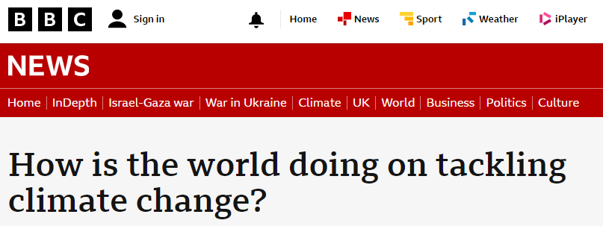
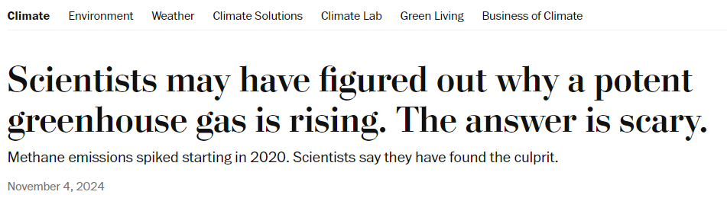

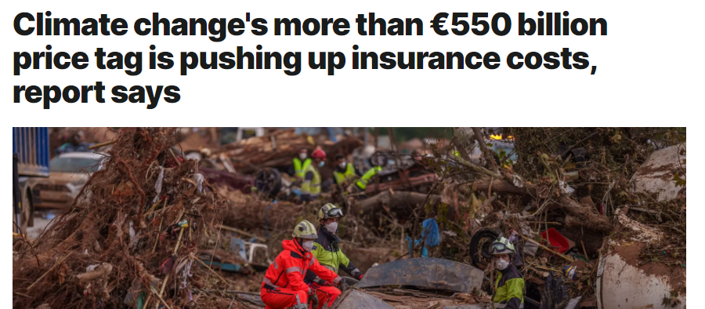
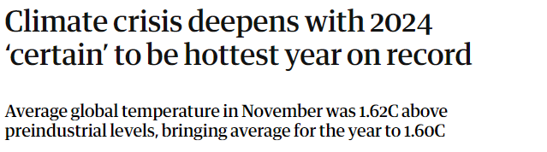
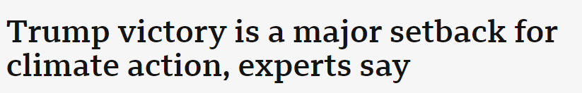
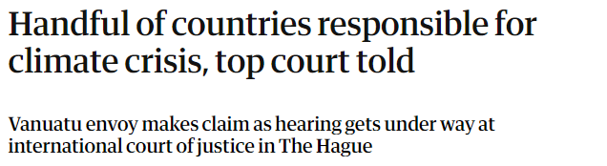
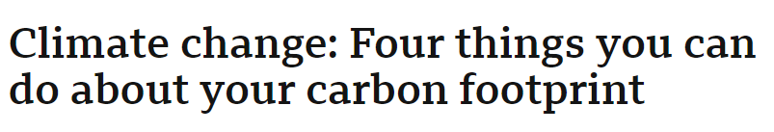
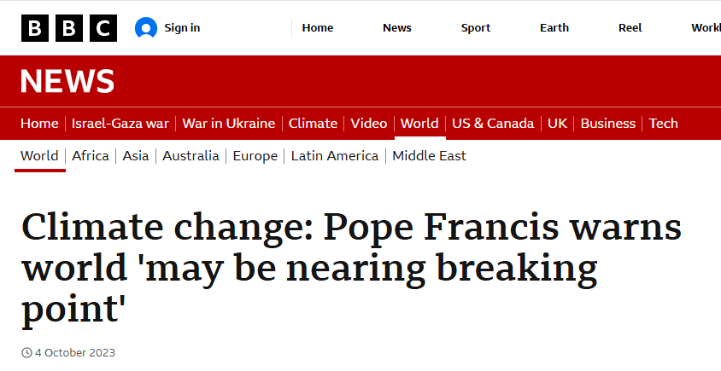
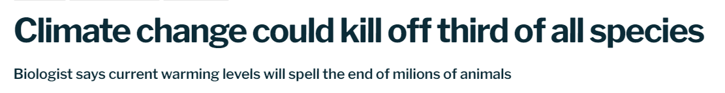
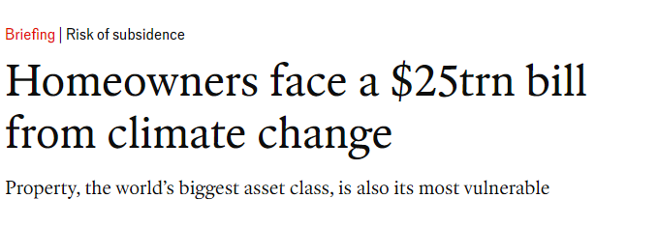
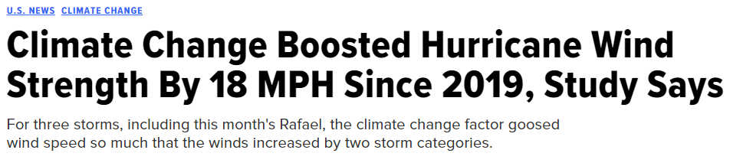
Have
you
seen anything
climate
about
change
in the news

Slide 27
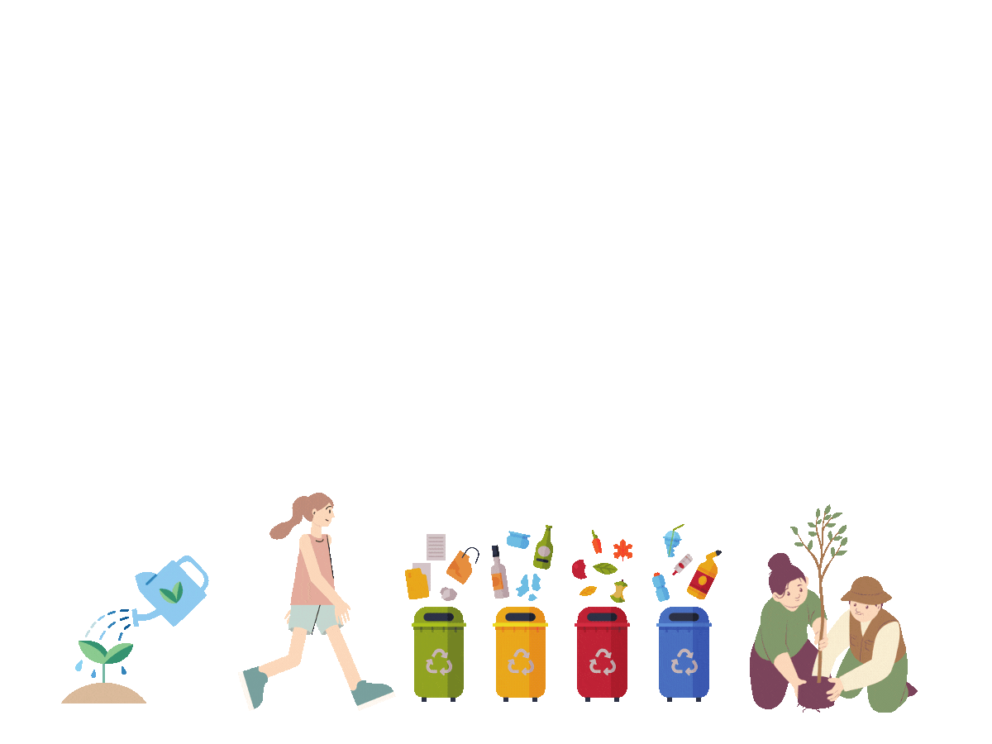
protect
Let’s discuss
some of the things
all do
we can
to
planet
the

Slide 28
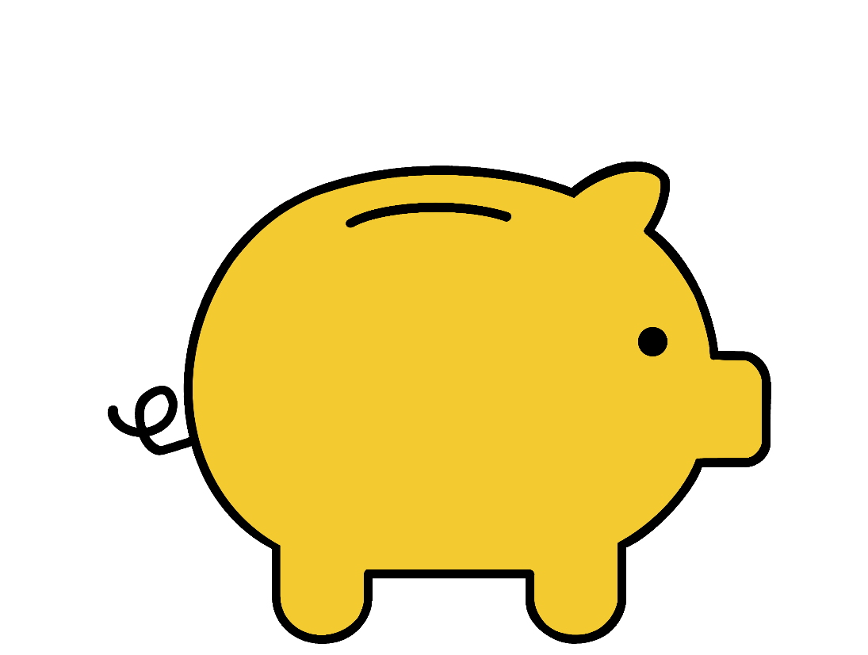
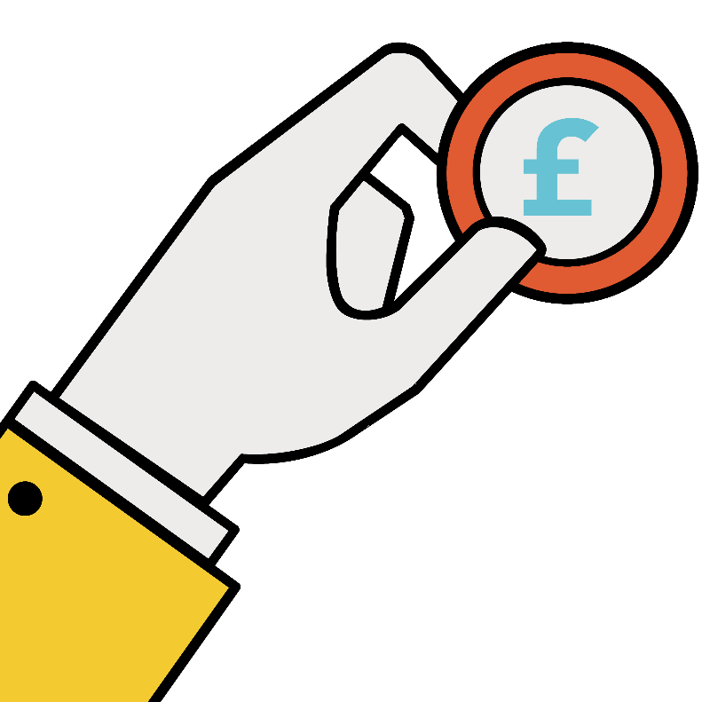

Save
money!

Slide 29
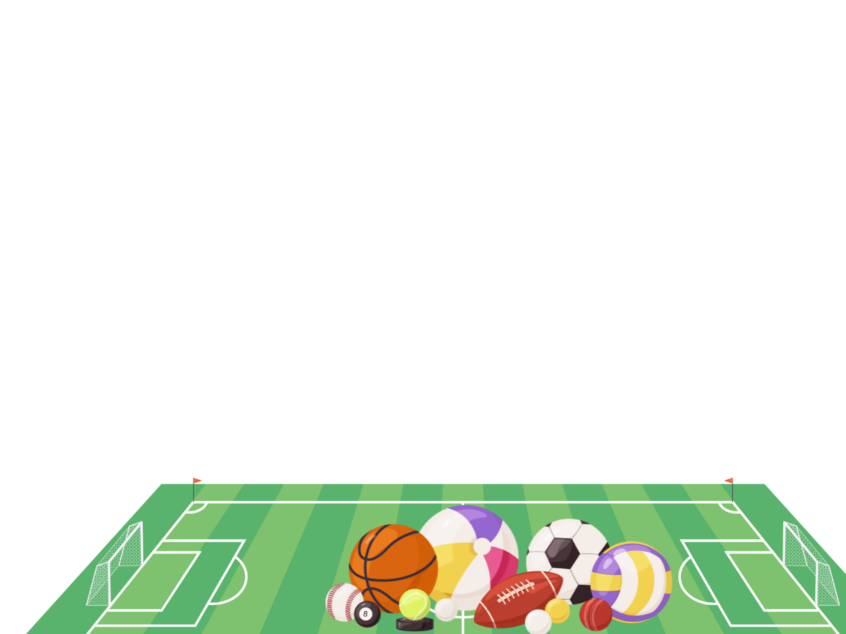
One primary school saved over
^{£82,000}
^{after spotting a spike in}
^{consumption}
Just think of how much new sports equipment you could buy with that money!
Notes:
Water saving for customers

Slide 30
Top tips
^{to} save water
^{at} school
&
^{at} home

Slide 31
1
Help
to save
water
turn off the tap!

Slide 32



If you
2
spot any
leaks
report them!
LEAK!

Slide 33

Have a
3
quick
shower
instead of a bath
it uses much less water

Slide 34

4
Chill your
tap water
in a water bottle
in the fridge
this will save water as you won’t
need to run the tap for a long time to get cold water.
One for your parents and
teachers here too – only fill the kettle with the amount of water you need

Slide 35

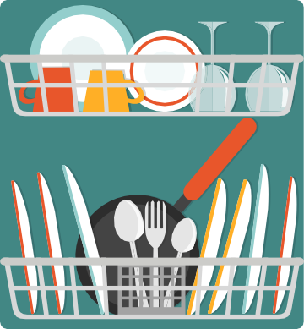
5
Only use the
washing
machine
and dishwasher
once they are full or set them to a half-cycle

Slide 36
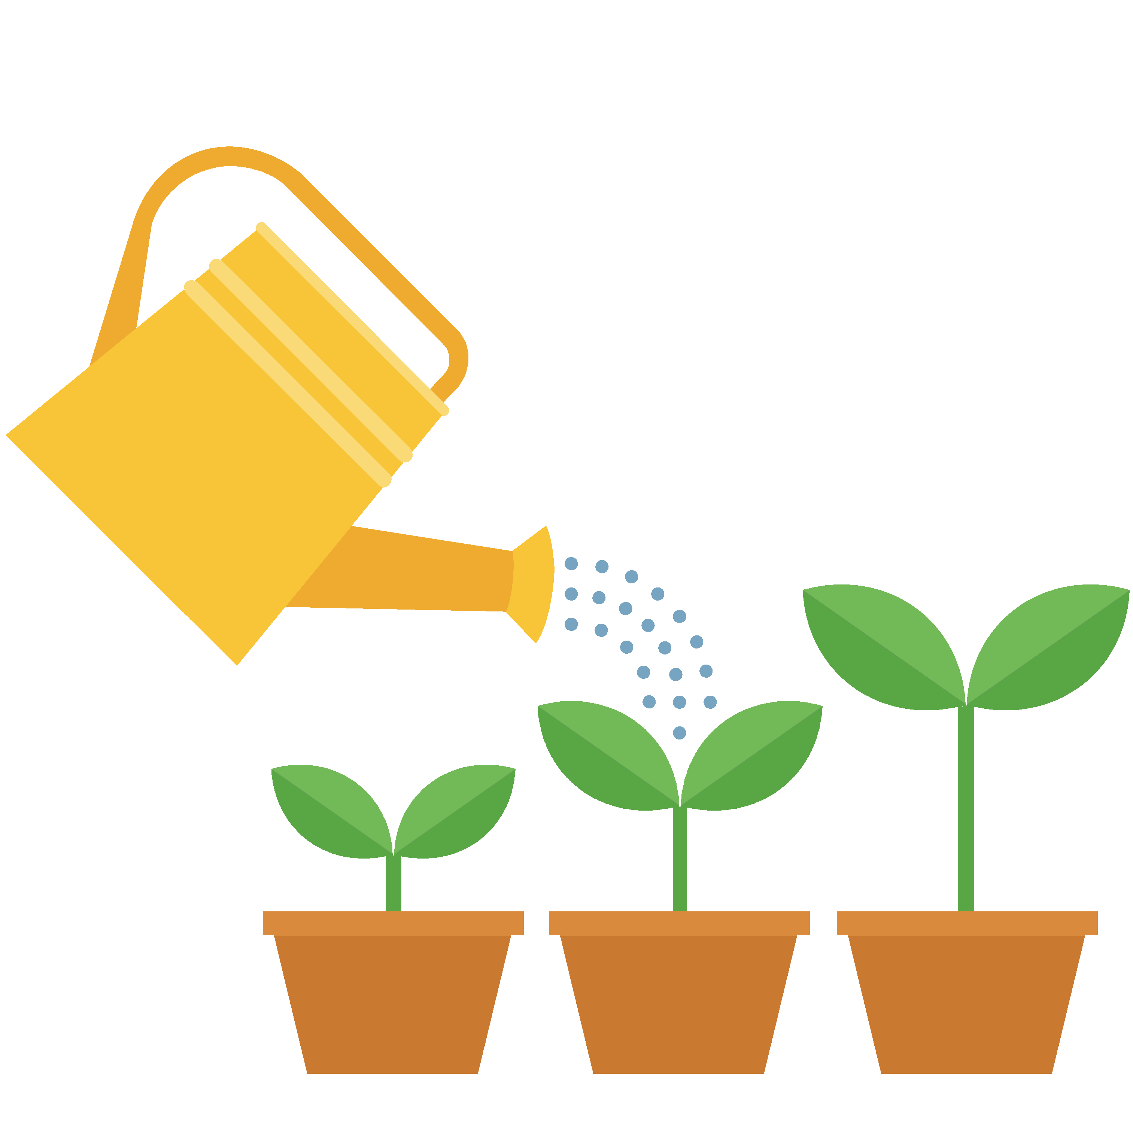
6
And for any
green
fingers
use a watering can rather than a hose to help save water

Slide 37
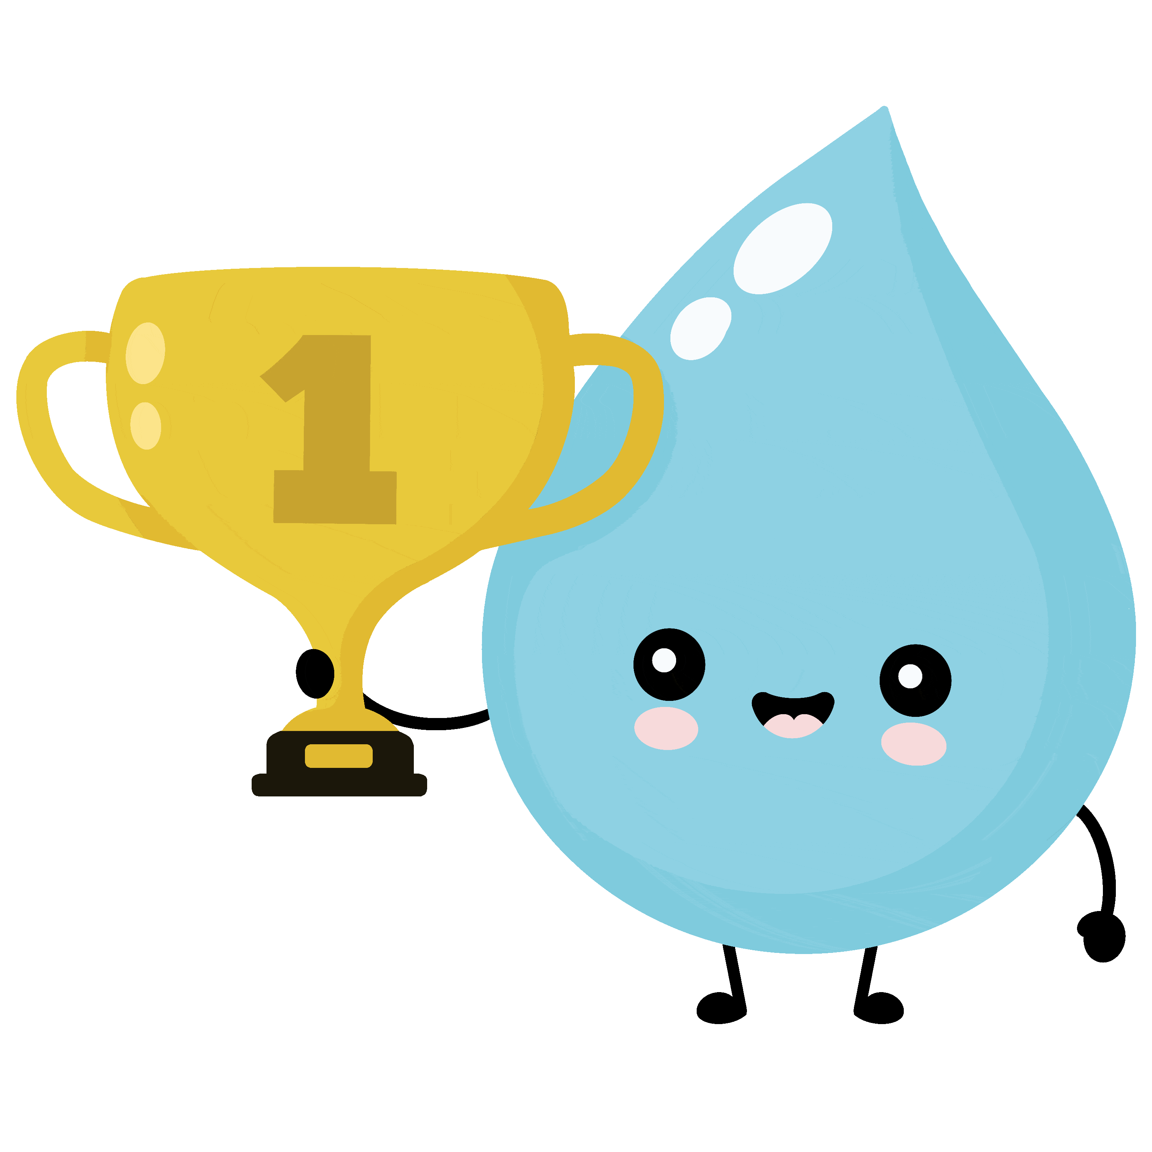
Play
7
your _{part}
and become a water efficiency champion at your school!

Slide 38

Can you think
^{of} any other
ways
^{to} save
water?

Slide 39



Poster
Use one or more of the top tips
challenge!
Make it stand out
Be creative
The challenge!
Design a water saving or a water saving superhero poster

